Slide 1
ECSE 371 Lab #1: AC and DC Circuits V24.6
Please answer the questions (•) that are included in the lab; record your data and scope traces (noted by (P)) in a lab report. All scope traces must contain annotation which clearly describes what is shown. For example, "Problem X at 2 kHz". Please have your report ready so we can so we can discuss it during recitation. Note the Saturday Schematic which is to be submitted for problems #5, #6, and #7. By preparing the Saturday schematics in advance, you will become familiar with the material well as the use of CircuitLab; this will save you significant time in the lab.
PLEASE READ “NOTE 1” REGARDING COMPONENT SELECTION.
Part I - DC circuits
1. •How much current flows in the leads of an ideal voltmeter? •How much voltage appears across the leads of an ideal current meter? A bench power supply contains a voltmeter and an ammeter. •Are both these meters accurate when you are interested in accurately measuring the voltage and current at a load that you have connected to the bench power supply with test leads ? Elaborate.
2(a) Measure the resistance of the provided 0.12 Ohm, 5% resistor. First, use the Keithley or HP bench DMM (6 ½ digits) in its “2-wire” measurement mode. Perform this measurement 5 times, unattaching and reattaching both clip leads each time. Use the appropriate “Ohms” range. •Record each reading. •What do you observe, and what is causing the variation in the readings (lack of repeatability) ?
2(b). Measure the same resistor again, using the DMM in its “4-wire” measurement mode. Unattach and reattach both clip leads as before and •Record 5 readings. •How do the results in 2(a) and 2(b) compare? Be prepared to discuss the two measurements. •Which technique is better, and why? •What is the concept behind the four-wire measurement, and what problem does it overcome? •Define “repeatability”, "resolution” or “precision", and “accuracy” or “calibration”? (See page #7).
You may have to research how and why you use the DMM to take a 4-wire measurement; Google the user manual for the instrument. Also, for the theory behind a four-wire measurement, please see the “Four-Wire Measurement” document in the Lab 1 Canvas Module.
3(a). Determine the I-V forward characteristics of a 1N4148 diode. Include a fixed series resistor to provide current- limiting and adjustment. •Prepare a graph in EXCEL of V vs I (I, the independent variable, is on the horizontal axis). Note that it is not necessary to take a lot of points everywhere, nor is it necessary to take high-resolution data -after all, the data will be used for a visual graph, not for precision measurements. •How many significant digits do you think it is appropriate to record? You must, however, take a suitable number of points in the “region of interest” (This is where an important, rapid change is occurring) •What would be an appropriate current range to graph? Suggestion: Google the part number to find a data sheet and look at the “Absolute Maximum” Ratings”. •Determine the series resistance of the diode. (Is it that simple? Think about it carefully.)
3(b). Measure and •record the internal resistance of one or two of the provided AAA and/or AA batteries. First, check that the battery is ‘good” and has an open-circuit voltage greater than 1.50 volts. •How do you think the internal resistance of a battery relates to its physical size, output current capability, capacity, and state-of-charge? Note that a fresh battery will have an open-circuit voltage of about 1.5 V. •How do you think the Rint of a 9 V transistor-radio battery would compare to that of the AAA and AA batteries?

Slide 2

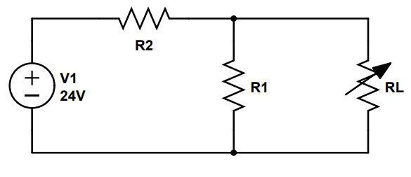
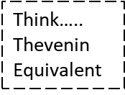
3 (c). A flashlight with a PR-6 incandescent lamp would use two AA cells in series. However, the PR-6 lamp is rated at 2.47 volts, not 3.0V. •Why? (P)
4. Design and test a circuit (consisting of one resistor) to power a #194 lamp from a 20 VDC bench supply. Find the specifications of this lamp and use Ohm’s Law to determine the value of a “dropping” resistor.
Set the bench power supply to 20V and the current-limit to its 5A maximum. Use your scope to •record the lamp-current waveform (P). Show the surge current (when the voltage source is first applied), as well as the steady-state current. Set the scope on “single-shot” and carefully adjust your trigger parameters. •What will be the “source” for the trigger signal?
NOTE: Connect the voltage to your circuit by using test leads to cleanly close the circuit, without bounce or arcing. Turning the bench power supply ON with its power switch is not suitable because of the very slow rise-time of the power supply output voltage. Also, the power-line transient caused by turning on the supply may trigger the scope at the wrong time. (Please remember these phenomena).
•Record the rise time of the current. •What lamp characteristic causes the current waveform to take this shape? •Calculate the required power rating of the resistor for continuous, steady-state operation. •In your circuit, what is the resistor’s maximum instantaneous power dissipation and when does it occur? Do you think the resistor you have chosen would provide reliable long-term operation?
You can plug the lamp directly into your solderless breadboard by carefully unfolding the bare leads, squeezing each loop together with a pliers, and inserting the leads into the breadboard. The squashed loop is about the right diameter for the solderless breadboard.
5. Design, build, and test a voltage divider that will provide 10.0 V +/- 10% to a load when driven from a 24.0 V “ideal” voltage source. The load, RL, will vary from “no-load” (“open circuit”) to 1K (“full-load”). The ability of a voltage source to maintain a fixed voltage with a changing load is characterized as its "voltage regulation". Obviously, the magnitude of the resistors in your voltage divider can vary over a wide range. •What practical considerations should you keep in mind when determining the magnitude of these components (what are the compromises and penalties)? See the figure below. •Record your final schematic.
•For Saturday, submit your circuit diagram and simulation results.

Slide 3
6. RC Low-Pass Filter
Design a passive, first-order low-pass filter (no op-amps or transistors) with a center frequency, fc, of 10 KHz. The input will be a bench sinewave generator and the output will drive a scope with a 10X probe (10MΩ). The series resistance of the function generator will be, as is most common, 50 ohms. (High- end function generators allow this to be set to 600 ohms or 50 ohms; better check yours) .
The straightforward way to approach this design would be use the equation that relates R, C, and fc. In this case, however, you're only given fc which leaves you with one equation and two unknowns. It will, therefore, be necessary for you to arbitrarily select an approximate value for one component, and then calculate a value for the other component. But, to do so accurately, you must include the effect of “loading”: It is essential that you design the filter with a high-enough input impedance such that it will not load (and reduce the amplitude) of the function generator, which has 50Ω output resistance. By the same logic, you must also design the filter with a low-enough output impedance such that it will not be loaded (and its signal amplitude reduced) by the input resistance of the scope probe. Note that the output resistance of the driving source and the input resistance of the load also affect fc. Please read this paragraph again.
One way to proceed would be to determine the equations that would include the output resistance of the source and the input resistance of the probe. By setting a value for the desired attenuation due to loading, you could solve for exact values of R and C.
This approach would, of course, take some time and is not mathematically precise because there is still some subjectivity involved. It is much quicker to use a little intuition and experimentation and avoid the complexity and labor of solving simultaneous equations:
First, select an arbitrary resistor value. You don't want to load the function generator, so the value of R should be large compared to the generator’s output resistance; how much larger depends upon how important it is to avoid attenuating the signal. A resistor value in the range of 30 to 50 times the generator resistance will usually work out well- the loading effect (2 to 3%) is small, and it is of the same order as the resistor tolerance. You don't want to make R too large, however, because you do not want the output of the filter to be loaded by the scope probe.
Next, calculate a capacitor value that will provide the desired cutoff frequency when paired with the resistor value chosen above. Then, select the standard capacitor whose value is closest to the value calculated above. See Note 1.
Now, calculate a new resistor value to work with the final, standard capacitor selected above. Finally, select the nearest standard value resistor. The result should be a filter that uses only standard values and provides a close approximation to the design specification.
From the above discussion, you can see the value of simulation software. Using the design approach above, use the CircuitLab simulation software to design this low pass filter. Be sure to include the generator output resistance and a load resistor In your model. •Submit a schematic and plots as your Saturday Schematic for this problem.
•Breadboard your LP filter. After performing a quick time-domain check on the oscilloscope using 2 channels (output versus input at a few frequencies including fc), perform a Frequency Domain Sweep of your breadboarded circuit using the Frequency Response Analysis (Bode Plot) feature of your oscilloscope. See Chapter 18, Page 305, of the Keysight User Manual; the link is posted in Canvas Modules and here: https://www.keysight.com/us/en/assets/9921-01422/user-manuals/InfiniiVision-3000T-X-Series-Oscilloscopes-Users-Guide.pdf •Record the Bode Plot. (P)

Slide 4
7. RC Bandpass Filter
Using CircuitLab, add a high-pass filter (fc = 1kHz) to your low-pass filter to create a bandpass filter. Use the approach described in Problem #6, ensuring that you do not load the first stage and can still drive the 10X (10MΩ) oscilloscope probe. By minimizing interaction (loading of the first stage by the second stage) we simplify the problem because we can design the stages independently and then simply connect them together without significantly affecting the performance of either stage.
For your Saturday Schematic for this problem, submit a schematic and plots of your simulated BP filter.
7(a). Using the simulated frequency-domain plot, determine the center-frequency of the bandpass filter. •Calculate and record the Q of the filter. (Q = Fc/BW; see the Lecture, RLC Circuits.\
7(b). Does it matter which filter, the low-pass or the high-pass, is placed first in your circuit? Investigate this with CircuitLab and explain (P).
7(c). Breadboard your circuit. After performing a quick time-domain check with the oscilloscope (input versus output), perform a Frequency Domain Plot of your breadboarded circuit using the Frequency Response Analysis (Bode Plot) feature of your oscilloscope. •Record the Bode plot (P).
7(d). How close did your breadboard match the simulated results? •Record your observations.
8. LC Bandpass Filter (Parallel Resonant Circuit)
Using CircuitLab, design a parallel LC resonant passband filter with Fc equal to the center frequency you found in 7(a); use a 47 mH inductor and choose values for C and R. See Slide 38 of the lecture, RLC Circuits. •Record your schematic and plots for your simulated circuit.
8(a). Using the simulated frequency-domain plot, determine the center-frequency of the bandpass filter. •Calculate and record the Q of the filter. (Q = Fc/BW; see the Lecture, RLC Circuits).
8(b). Breadboard your circuit. After performing a quick time-domain check with the oscilloscope (input versus output), perform a Frequency Domain Plot of your breadboarded circuit using the Frequency Response Analysis (Bode Plot) feature of your oscilloscope. Record the Bode plot (P).
8(c). How close did your breadboard match the simulated results? •Record your observations.
8(d). How does the performance of this filter compare to that of the 2-stage RC bandpass filter in Problem 7? Record and explain your observations. •What might explain the differences that you observe?
An important comment regarding the oscilloscope display of AC waveforms. If your horizontal sweep frequency is too low, you will display many waveform cycles, but they will be scrunched together and it may be difficult to see details. On the other hand, if you set the sweep frequency too high, you will only display a fraction of a cycle or less; therefore, you may hide a portion of the waveform. Unless you have a good reason to do otherwise - such as trying to display a waveform envelope - you should always display only three or four cycles of the waveform. For similar reasons, you should adjust the vertical sensitivity to fill as much of the screen as possible.

Slide 5
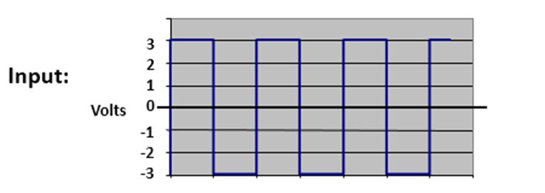

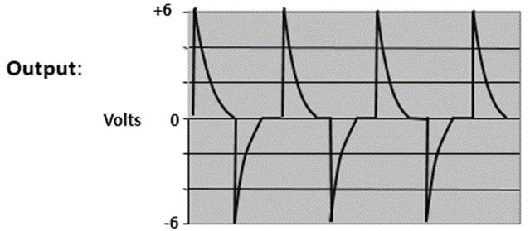

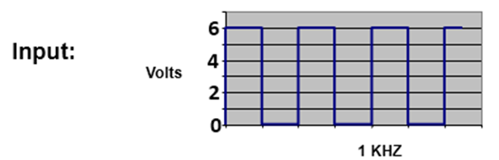
9. Differentiation
Design an RC circuit that will produce ‘spikes” when its input is driven with a 2.5 KHz square wave (-3V to +3V) as shown:
2.5 KHz, 50% duty- cycle
The output should look something like this:
The load will be 100K (plus the 10M scope in parallel).
9(a). Record waveforms as you change function generator amplitude and frequency. (P) •Be prepared to discuss waveforms and operation of the circuit. (Use the capacitor “axiom”).
9(b). How does the output change shape as the duty cycle, frequency, and amplitude of the input are increased and decreased ? Explain and record a few representative waveforms. (P)
9(c). You have been considering the differentiator’s transient response, but it is also a filter when its sinusoidal response is considered. •What components of the input waveform is the filter passing?
10. INTEGRATION
Design a circuit to integrate (filter or “smooth”) the 2.5 kHz, zero to six- volt input pulse shown below. The load will be 100K (plus the 10M scope in parallel). Select values so your output will have 10% to 20% “ripple”. (Ripple is defined as the peak-to-peak voltage of the AC component divided by the average DC voltage, X 100%.)
Provide a scope trace. (P)
10(a). Draw your schematic.
10(b). What is the relationship of (average) DC output voltage vs duty-cycle and frequency of the input? In other words, how does the average DC voltage change with changes at the input?
10(c). How does the load affect the ripple? • DC output voltage vs load? • How would you define the value of a DC voltage that has ripple? Provide some representative scope traces for 10(b) and 10(c) (P).
10(d). What happens to the output when the input to your filter is the 1KHz, -3V to +3V square wave from Problem 10? •What can you conclude about the average value of a square wave or sinewave?
10(e). Select values for an integrator which will convert the 1KHz, -3V to +3V square wave to a reasonable sine wave. •How can you improve the “quality” (harmonic distortion) of the sine wave? •What happens to the amplitude of the sine wave as its quality improves? (P)
10(f). Thinking of the integrator as a filter, what components of the input waveform are being passed by the filter?
10(g). Try adding an integrator stage to improve the sine wave quality. Keep the load the same.
•Why does adding the stage help?
Keep this breadboard assembled for your recitation.
2.5 KHz, 50% duty- cycle

Slide 6
11. “One-Shot” timer
Design a circuit that uses an incandescent lamp as a "timing" element (NO CAPACITORS or INDUCTORS). When a DC voltage is applied (step function) to your circuit, a red LED will flash for a fraction of a second.. The circuit “resets” when the applied voltage is OFF for several seconds and is then ready for another actuation. You will use a #194 lamp, operated at about 13 VDC. Be sure that the current limit on your bench power supply is set to maximum. Why? The flash duration is not important, but the LED should be visible and bright. •Record your schematic (P). Keep this circuit built and working for recitation. Can you sketch a resistor-capacitor circuit that will do the same thing? (P)
This circuit exploits the fact that incandescent lamps have a relatively long thermal/electrical time constant. Before attempting to design your circuit, experiment with the lamp to determine its characteristics and review your scope traces from Problem #4. This circuit may seem crude, but before solid-state electronics, the use of thermal delays as timing elements was very common. Now, large, self-heating thermistors (temperature-dependent resistors with thermal time-constants ) are commonly used for limiting inrush current and for use as resettable fuses.
For recitation, provide annotated scope traces, schematics, and data as requested.
For Problems 10 and 11, keep the breadboards for built for recitation .
Note 1: IMPORTANT! PLEASE READ THESE GENERAL GUIDELINES ON COMPONENT SELECTION:
When designing a network such as a filter, you will usually choose an arbitrary value for one component and then calculate a value for the others. Since capacitors are much more expensive and are usually stocked and available in far fewer values than resistors, it is always best to select the capacitor first and choose a common, "nice" decimal value, such as 0.1 µF, 100 pF, etc. (although 22 and 47 might sometimes be necessary. (Avoid 68 and 82; they can be hard to find). Then calculate the exact resistor value and use the nearest standard value.
The same logic holds for LC resonant circuits and LR filters. In this case, inductors are very expensive and are available in few values. Therefore, it is essential to select a common, available, inductor value and then choose the resistor or capacitor. With inductors, you will be limited to values provided in the lab.
In general, when selecting an arbitrary, noncritical component value, ALWAYS select a "nice“ value that is common, readily stocked and, if possible, is already used in your project - such as 1K, 10k, 0.1uF, etc. Choosing an oddball value, such as 385 ohms or 110 K, may imply unnecessary precision and will increase cost.
Do NOT bother to add resistors in series or parallel to make a value that you need. You can get close enough with a standard value. Also, it is usually a waste of time to measure resistors; it is extremely unlikely that they will be out of tolerance. The exception is when it is difficult to read the color code.
Components are available in different "series". For example, resistors with a tolerance of 10% are available in decimal multiples of the following values:
100, 120, 150, 180, 220, 270, 330, 390, 470, 560, 680, 750, 820, 1K, 1.2K, and so on.
Resistors with a tolerance of 5% are available in the following values (about twice as many):
100, 110, 120, 130, 150, 180, 200, 220, 240, 270, 300, 360, 390, 430, 470, 510, 560, 680, and so on.
Precision resistors, with a tolerance of +/-1% (or even .01%), are available in a zillion values such as “71.6K”. In general, a resistor with a tighter tolerance will also have a lower (better) temperature coefficient.
When working with audio frequencies, you should always try to select capacitor values that are in the range of 0.1uF or less. This is a good rule-of-thumb, because capacitors much larger than this tend to be bulky and expensive. In fact, capacitors larger than around a 1uF will generally be “electrolytic”. These capacitors are polarized and cannot be used for AC applications; Also, they usually have very poor tolerance compared to ceramic and film capacitors.
For more information on standard values, see : http://www.rfcafe.com/references/electrical/resistor-values.htm

Slide 7
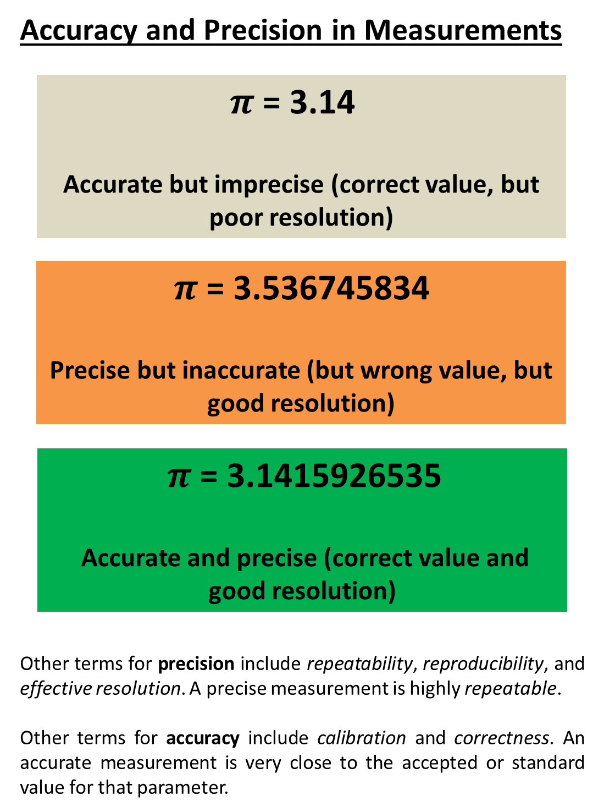
And, of course, don't forget Accuracy and Precision in Measurements

